Slide 1
Alternatives to Rules

Slide 2
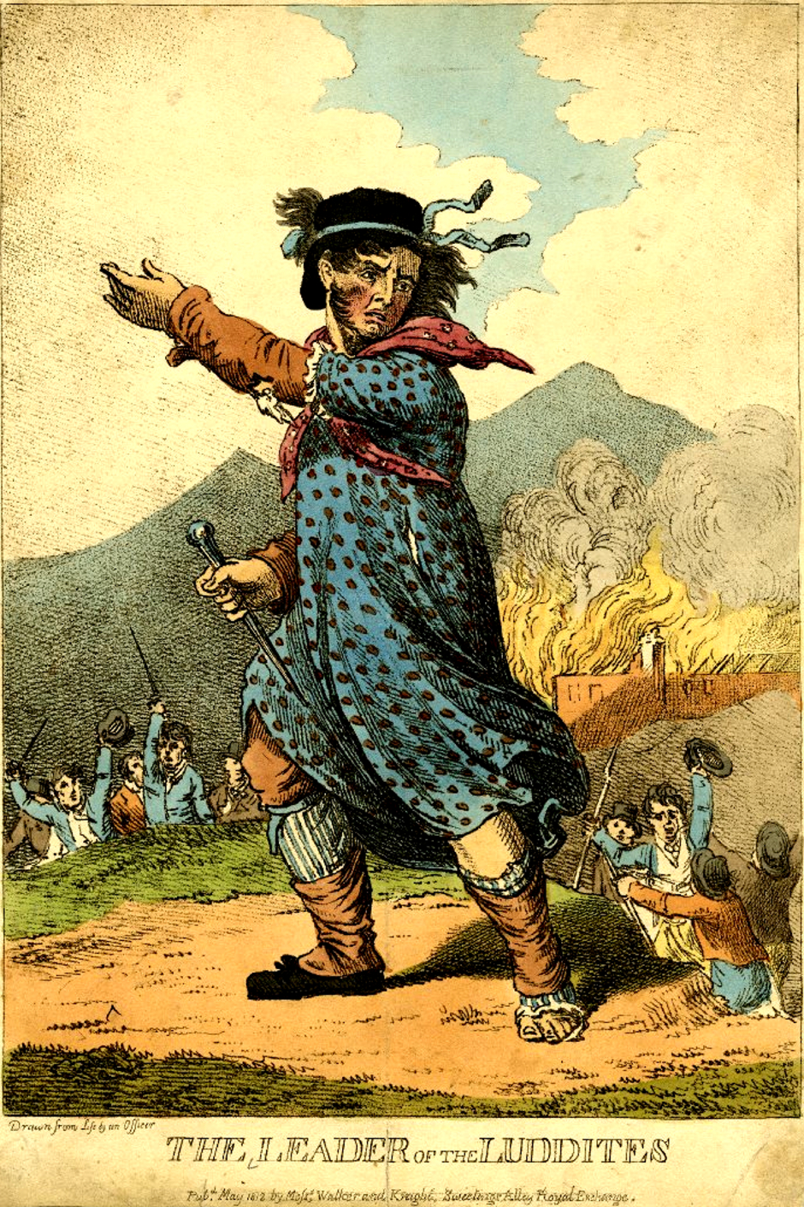
We are not luddites…
Luddites = English workers who destroyed machinery
Notes:
We don’t want to “destroy ML”. So let’s take a look at what can be done with ML.

Slide 3
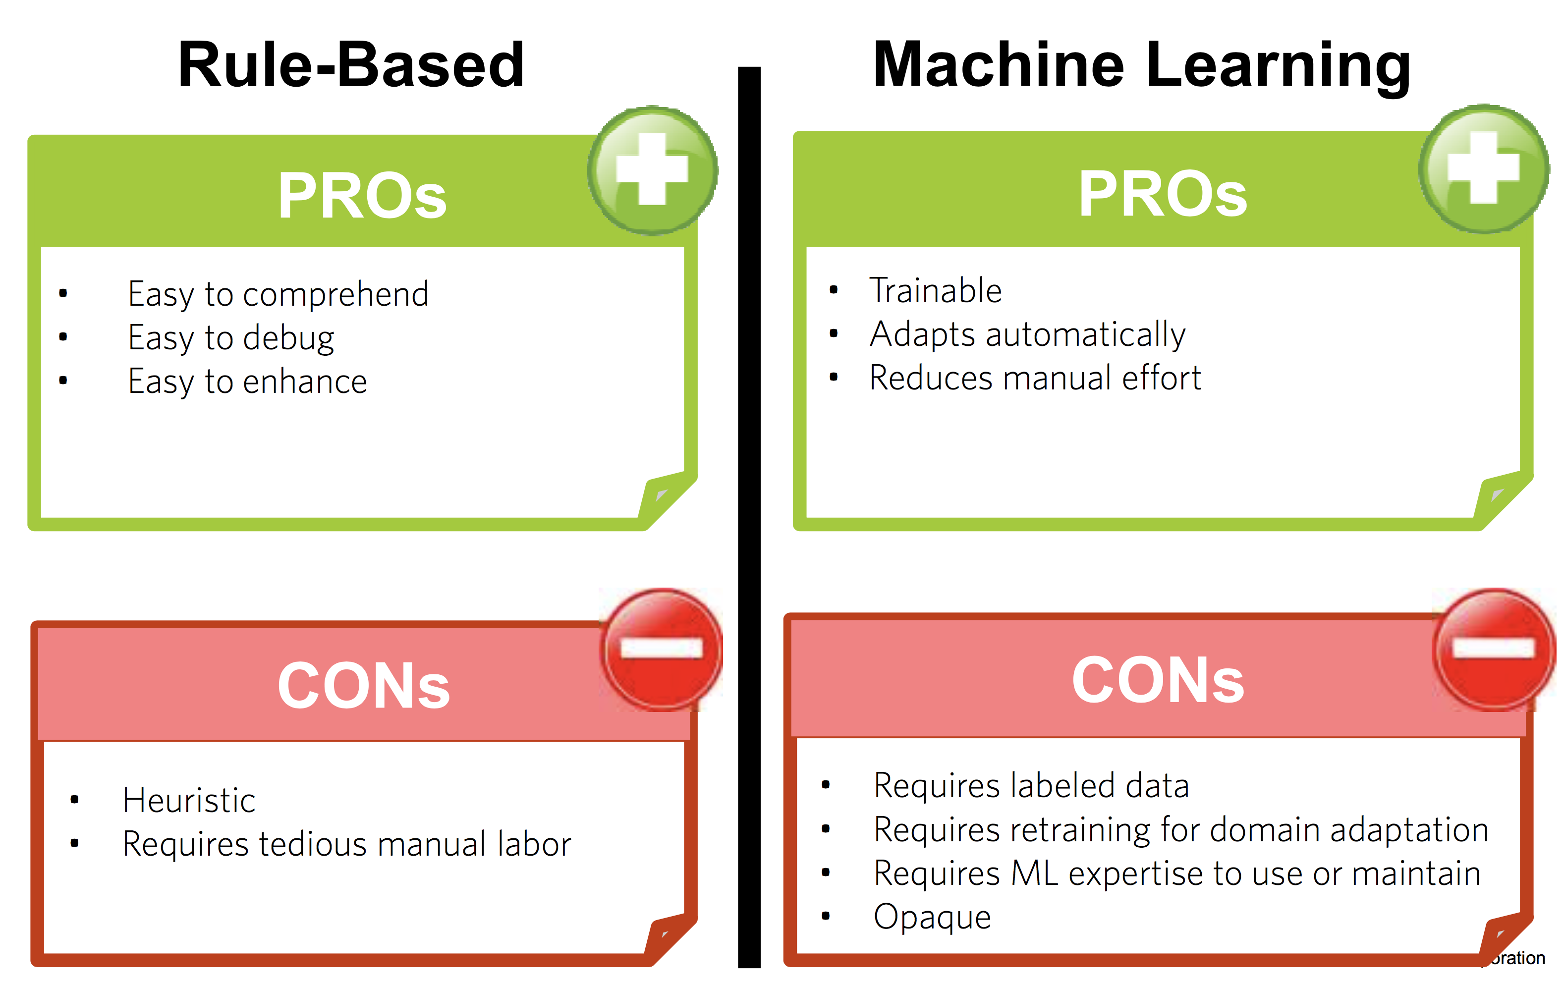
Rule-based vs. machine-learning systems
We’ll propose a solution later
(slide by Laura Chiticariu, EMNLP 2015)

Slide 4
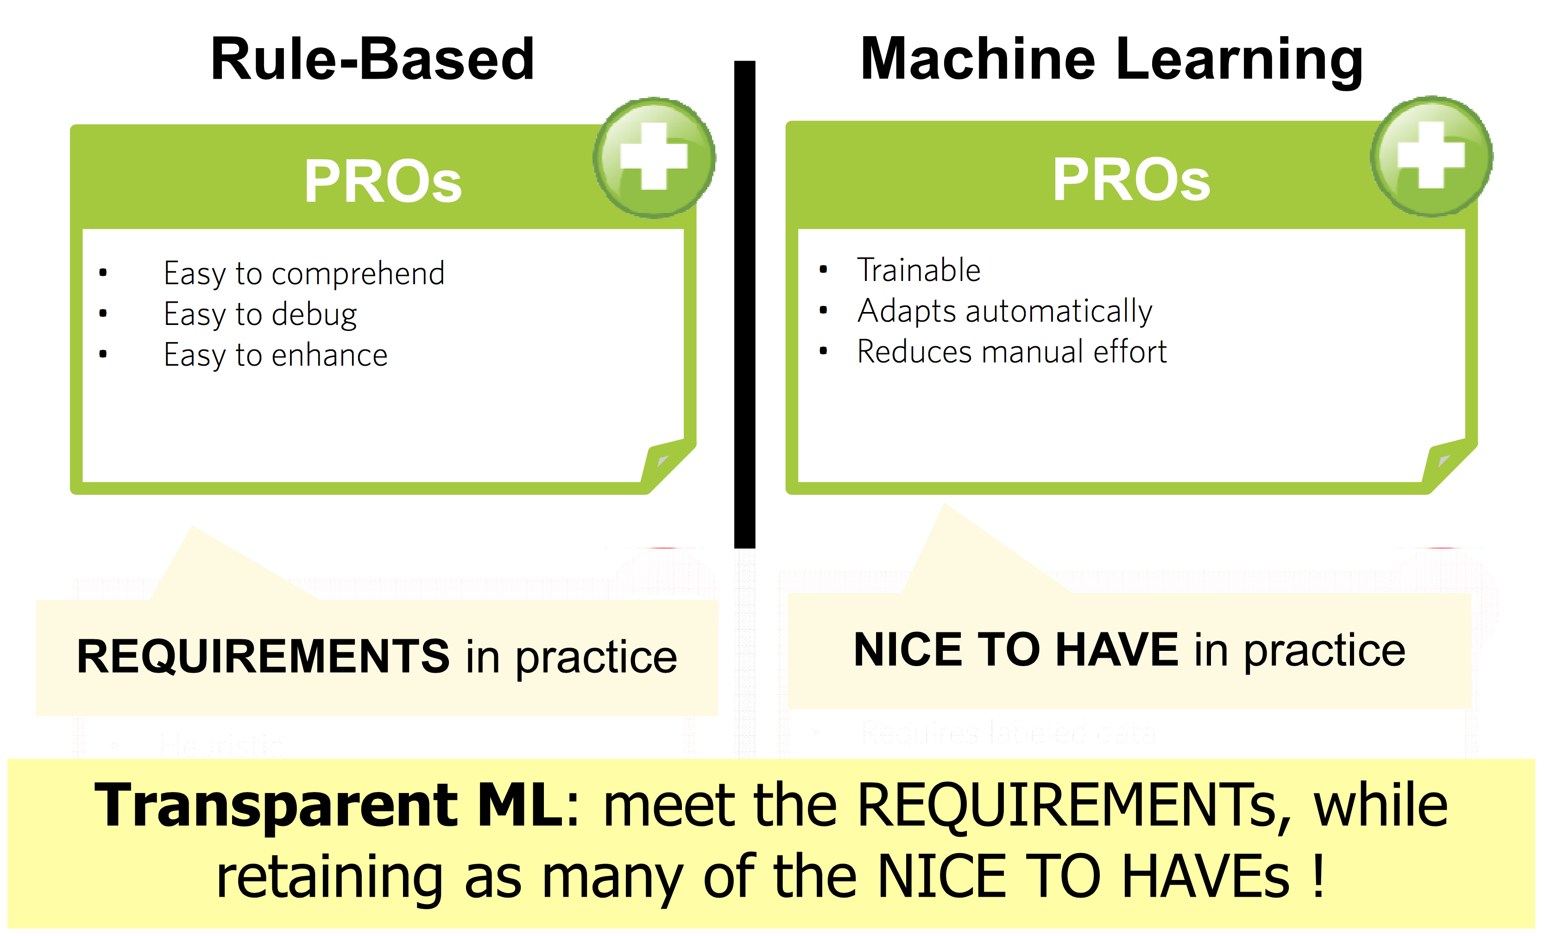
Rule-based vs. machine-learning systems
(slide by Laura Chiticariu, EMNLP 2015)

Slide 5
A few options
“Traditional” ML for relation extraction
Deep learning for relation extraction
Hybrid approach: AMR + rules
Learning rules

Slide 6
A few options
“Traditional” ML for relation extraction
Deep learning for relation extraction
Hybrid approach: AMR + rules
Learning rules

Slide 7
BioNLP 2009 Shared Task
CD2 signaling induces phosphorylation of CREB in primary lymphocytes.
Input
Protein
Output
Notes:
Relation Trigger-Protein
Relation Trigger-Trigger for nested events

Slide 8
BioNLP 2009 Shared Task
CD2 signaling induces phosphorylation of CREB in primary lymphocytes.
Input
Protein
+Reg
Phosphorylation
Classifier #1:
detect event triggers
Output
Notes:
Relation Trigger-Protein
Relation Trigger-Trigger for nested events

Slide 9
BioNLP 2009 Shared Task
CD2 signaling induces phosphorylation of CREB in primary lymphocytes.
Input
Protein
+Reg
Phosphorylation
Classifier #1:
detect event triggers
Output
Classifier #2:
detect relations between triggers and proteins
Notes:
Relation Trigger-Protein
Relation Trigger-Trigger for nested events

Slide 10
Training the statistical model
We use logistic regression for both classifiers
Feature selection through regularization
L2: better performance; too many features
L1: aggressive selection; slightly lower performance
Notes:
Any classifier that assigns weight to features could be used
(e.g., perceptron, linear svm)
L1 regularization is well-known in the ML community
We need to reduce the number of features.
One million interpretable rules are not interpretable!

Slide 11
Machine learning features
Triggers
Relations
Token
Word, lemma, gazetteer
Surface
Token features for a window around token of interest
Bigrams
Syntax
Dependency paths up to depth 2
Token features for token at the end of each path
Bag-of-words and entity count
For whole sentence
For window surrounding token of interest
Path
Shortest dependency path between nodes of interest
With and without lexicalization
Path length
Surface
Words surrounding and between nodes of interest
Consistency
Soft constraints on edges between trigger and arguments (e.g., only regulations have causes)
N-gram
Dependency, token, dependency
Token, dependency, token

Slide 12
Discussion
Advantages
Trainable; reduces manual effort
Disadvantages
Sensitive to the sparsity of the text (what happens when a new word is seen in test?)
Requires labeled training data
Relatively opaque

Slide 13
A few options
“Traditional” ML for relation extraction
Deep learning for relation extraction
Hybrid approach: AMR + rules
Learning rules

Slide 14
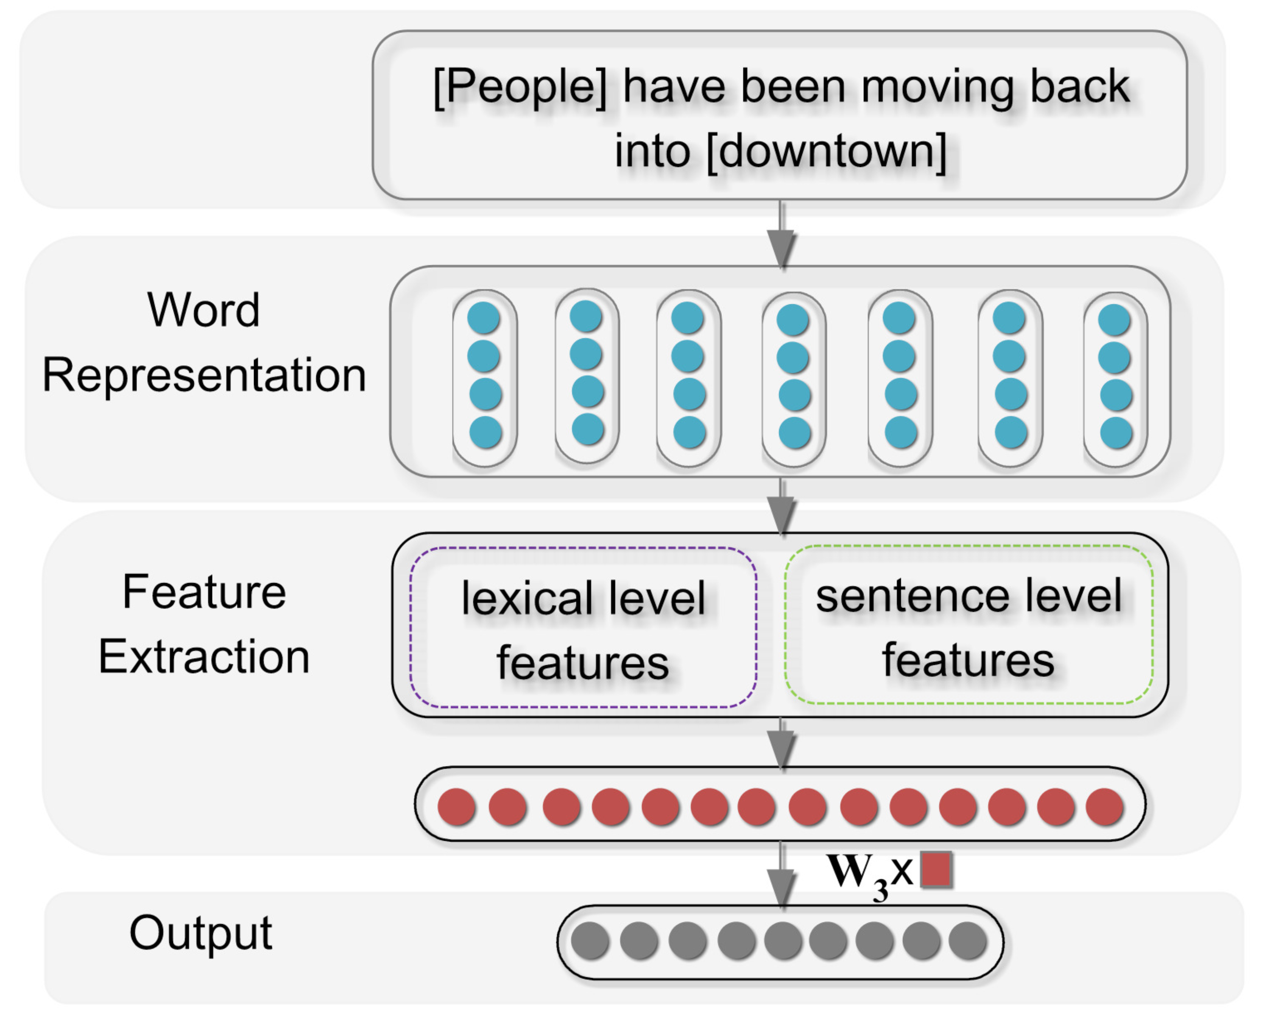
Architecture [Zeng et al., 2014]

Slide 15
Word Representations
Each word is projected into a vector of N dimensions based on distributional similarity
“You shall know a word by the company it keeps” (Firth, 1957)

Slide 16
Lexical-level Features
Bag-of-words approach
Generate a new vector by averaging the word embeddings of marked nouns and their context tokens

Slide 17
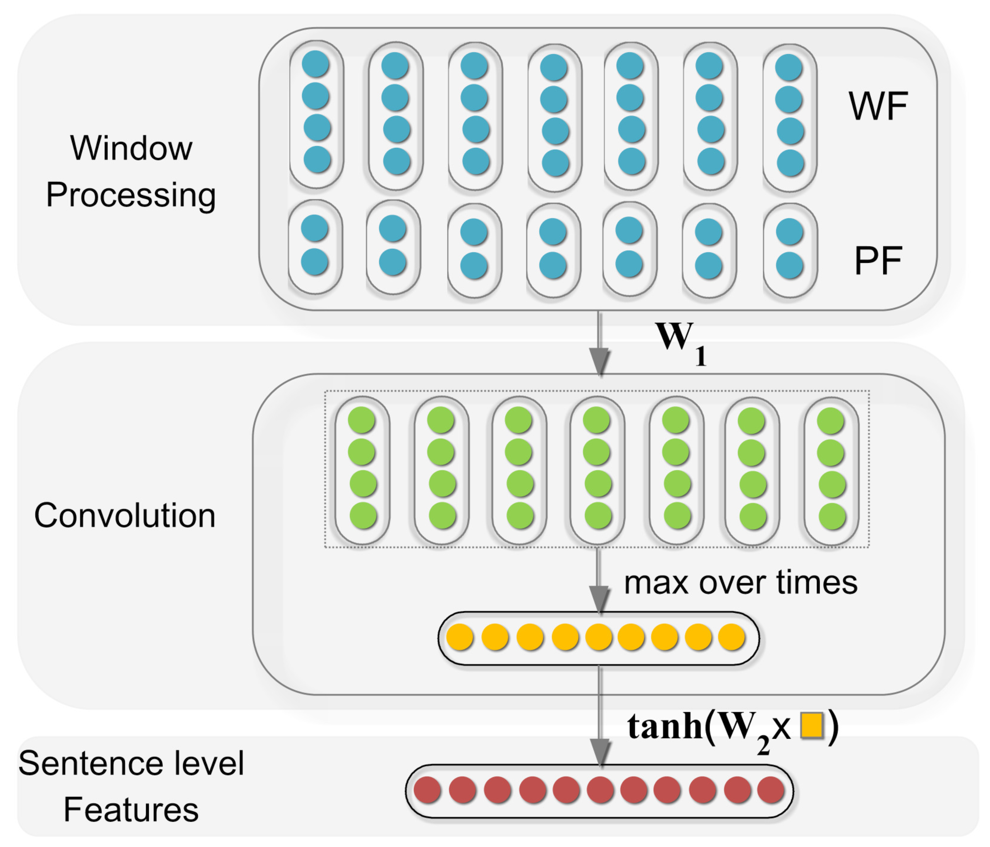
Sentence-level Features
WF = combined word + context (+/- 1 word to the left/right) vectors
PF = position vectors, encoding the distance between the current word and the arguments of the relation
Standard convolution(s) over the WF+PF vectors

Slide 18
Discussion
Advantages
Trainable; reduces manual effort
Less sensitive to language sparsity (the embeddings are supposed to encode semantics rather than actual lexical tokens)
Disadvantages
Requires labeled training data (more than the previous approach)
More opaque than the previous approach

Slide 19
A few options
“Traditional” ML for relation extraction
Deep learning for relation extraction
Hybrid approach: AMR + rules
Learning rules

Slide 20
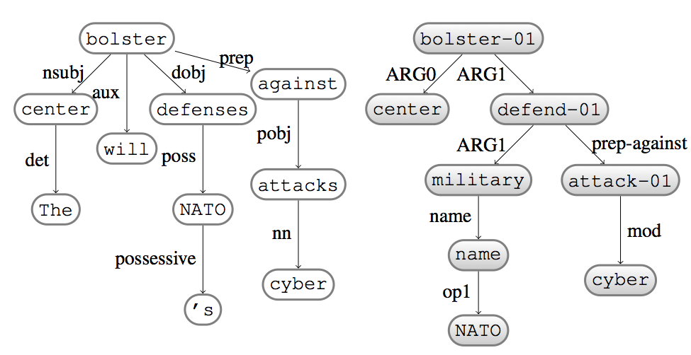
Step 1: Open domain extraction of shallow semantics

Slide 21
Step 2: Map to domain-specific semantics using rules, or another ML component
IF
Predicate = “phosphorylate”, AND
ARG0 is Protein, AND
ARG1 is Protein
THEN
Controller = ARG0
Controlled = ARG1

Slide 22
Discussion
Advantages
Less opaque
You can train the AMR parser using open-domain resources, which are more easy to obtain than domain-specific texts
Disadvantages
Requires labeled training data for the AMR component
AMR parsers do not perform too well today
Hard to fix when the mistake is in the AMR parser

Slide 23
A few options
“Traditional” ML for relation extraction
Deep learning for relation extraction
Hybrid approach: AMR + rules
Learning rules

Slide 24
Goals
Use ML to learn rules
For ML, use representation learning, the key component of deep learning that addresses the sparsity of language
Very light supervision: learn from a few examples
Notes:
We want an approach that is…

Slide 25
Key ideas (using taxonomy acquisition as example)
We embed (i.e., generate dense vectors for) both concepts to be learned and the patterns that match them
Concept = entity to be learned
Context = all patterns that match it
Idea 1: the embeddings of patterns should be semantically close to the embeddings of the concepts
Idea 2: the embeddings of the concepts in one category should be close to each others
Idea 3: the embeddings of concepts in different categories should be far apart

Slide 26
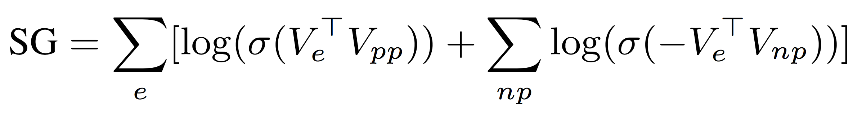
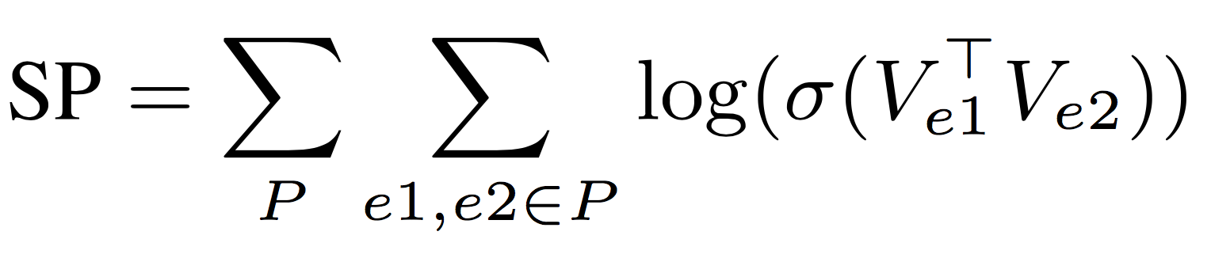
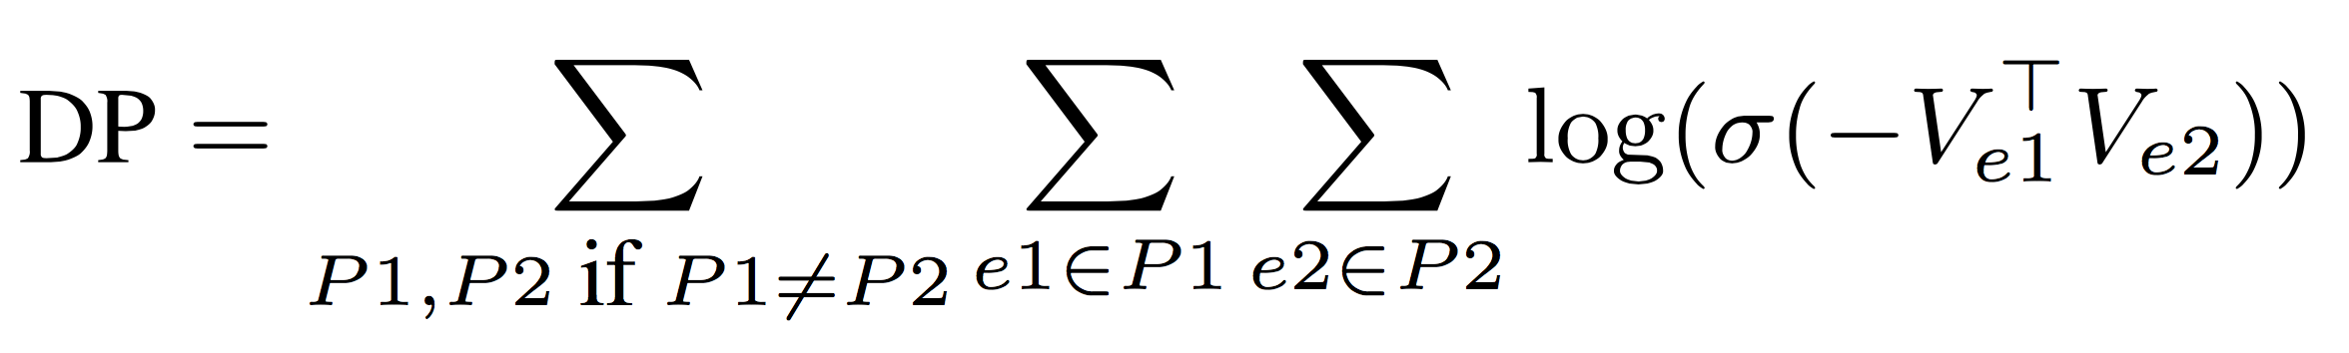
Objective function
J = SG + SP + DP

Slide 27
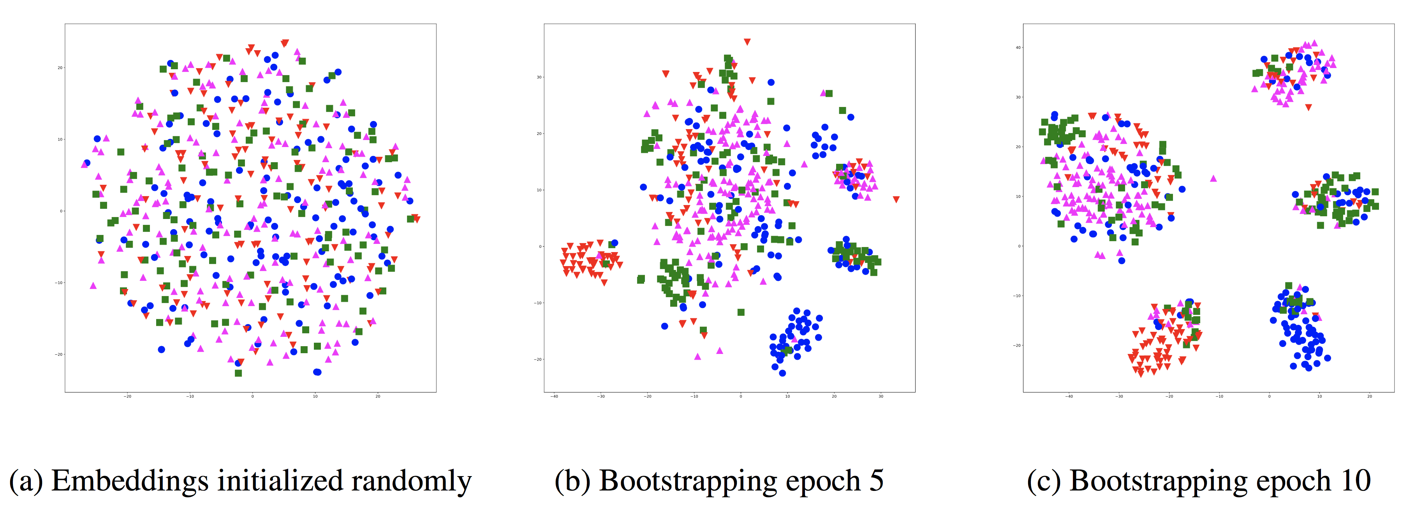
Learning process

Slide 28
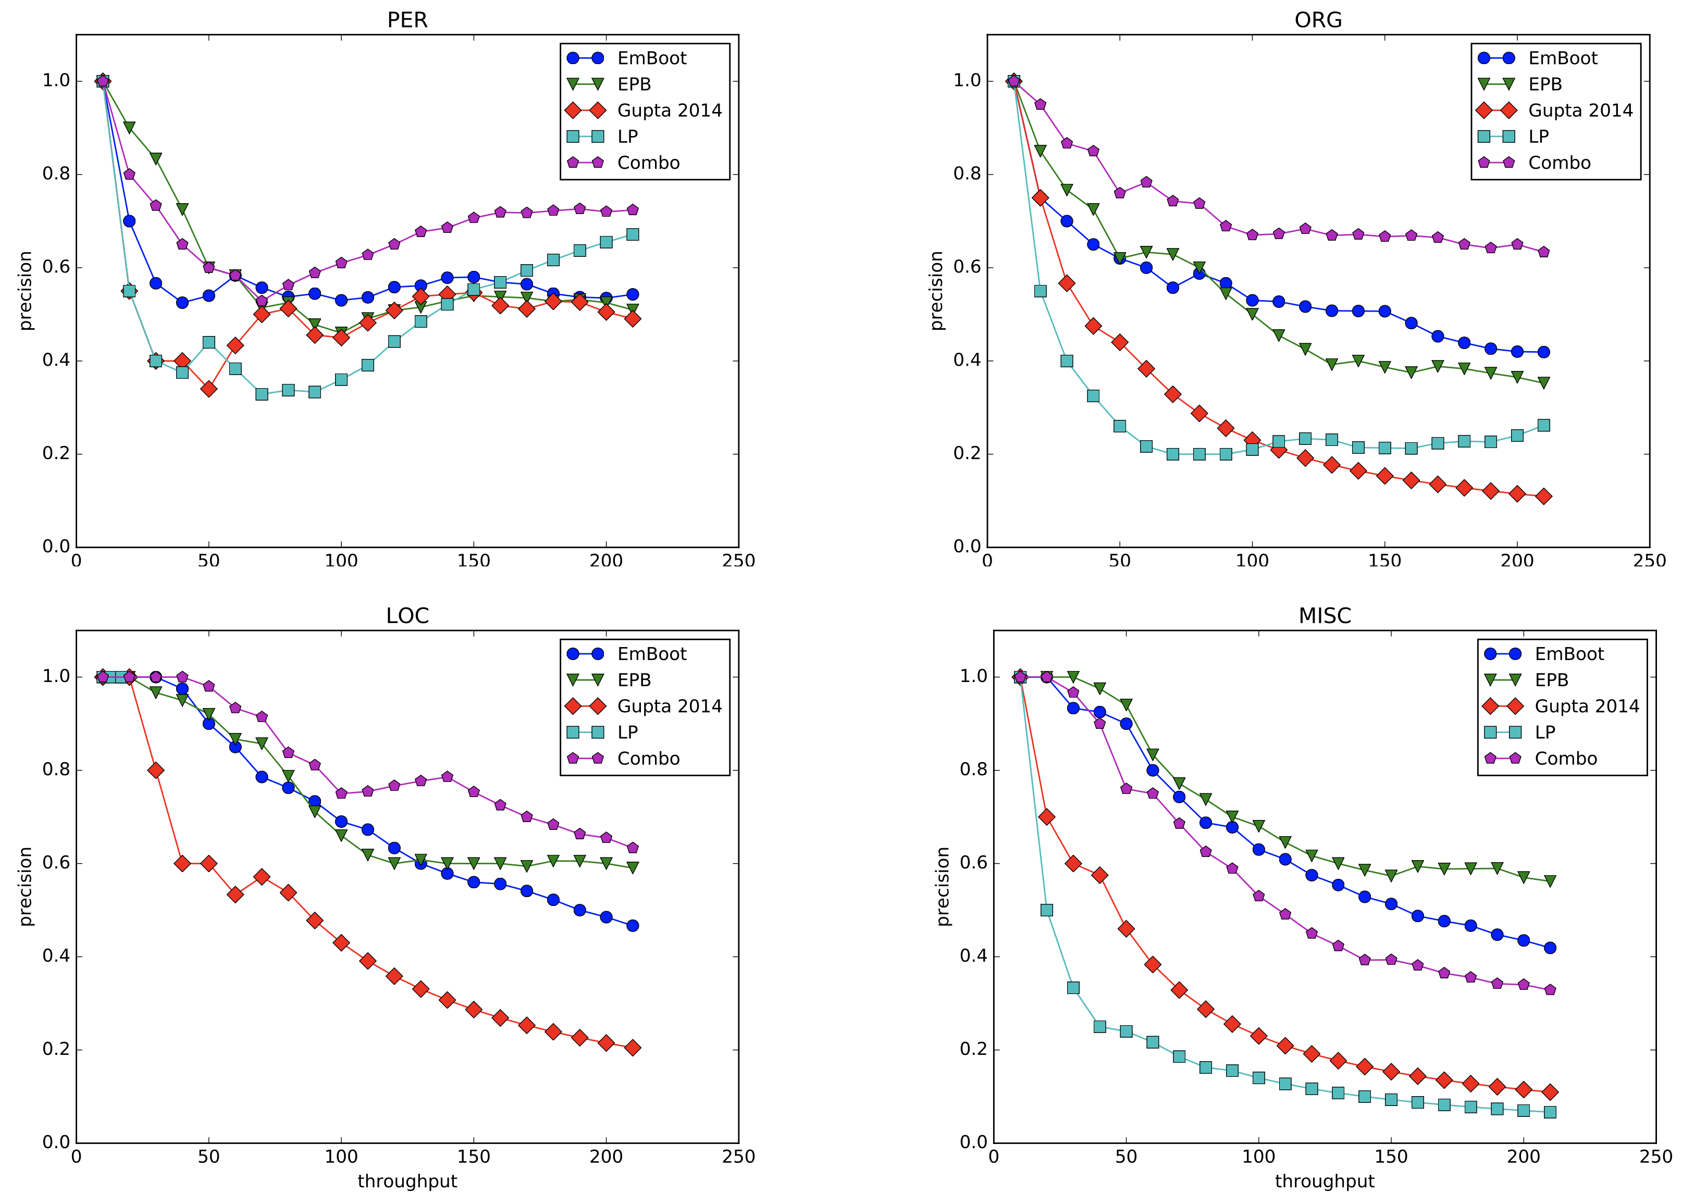
Results

Slide 29
Discussion
Advantages
Blends advantages of ML with rules
Lightly supervised
Not opaque; easy to debug and fix
Disadvantages
We tested it for taxonomy acquisition; not sure how well it works for learning biomedical relations

